Slide 1


<Name>
<Date>

Slide 2

Outline
Executive Summary
Introduction
Methodology
Results
Conclusion
Appendix

Slide 3
Executive Summary
The study aims to identify the crucial components contributing to successful rocket landings using various methods: collecting data through SpaceX REST API and web scraping, organizing data to define success/failure parameters, analyzing factors such as payload, launch site, flight number, and annual trends through data visualization, conducting statistical analysis including payload metrics and success rates using SQL, investigating launch site success rates and geographical proximity, visually representing successful launch sites and payload ranges, and creating predictive models such as logistic regression, support vector machine (SVM), decision tree, and K-nearest neighbor (KNN).
Exploratory Data Analysis suggests a rise in launch success over time, with KSC LC-39A leading among landing sites, and certain orbits achieving flawless success. Visualization and analytics illustrate the geographic dispersion of launch sites. Predictive Analytics show similar performance across all models, with the decision tree model slightly surpassing others.

Slide 4
Introduction
SpaceX endeavors to democratize access to space by employing inventive methods to keep costs down, notably through the reuse of the Falcon 9 rocket's first stage. This approach allows for launches priced at $62 million, significantly lower than the $165 million cost associated with competitors who lack similar reusability capabilities. Utilizing machine learning and publicly available data, it becomes feasible to forecast the success of first stage landings, thus influencing the pricing of launches and advancing the accessibility of space exploration.

Slide 5

Section 1

Slide 6
Methodology
Executive Summary
Data collection methodology
Perform data wrangling
Perform exploratory data analysis (EDA) using visualization and SQL
Perform interactive visual analytics using Folium and Plotly Dash
Perform predictive analysis using classification models

Slide 7
Data Collection
The procedure begins by retrieving rocket launch data from the SpaceX API, followed by decoding the response using .json() and transforming it into a dataframe via .json_normalize(). Custom functions are utilized to gather launch information from the SpaceX API, which is then structured into a dictionary and converted into a dataframe. Filtering is employed to isolate Falcon 9 launches, and any absent Payload Mass values are substituted with the computed mean. Ultimately, the data is exported to a CSV file to facilitate additional examination.

Slide 8
Data Wrangling
During the exploratory data analysis (EDA), the objective is to define data labels through several computations. This involves identifying the count of launches per site, analyzing the frequency of various orbits and mission outcomes based on orbit types. Furthermore, a binary landing outcome column is generated as the dependent variable for subsequent analysis. Ultimately, the refined dataset is exported to a CSV file for future reference and examination.
The classification of landing results includes designations such as "False Ocean," indicating a failed landing in a specific ocean region, "True RTLS," representing a successful landing on a ground pad, and "False RTLS," indicating an unsuccessful ground pad landing. "True ASDS" denotes a successful landing on a drone ship, while "False ASDS" signifies an unsuccessful landing on a drone ship. These classifications are then converted into binary values, with successful landings represented as 1 and unsuccessful ones as 0.

Slide 9
EDA with Data Visualization
The examination of flight data involves presenting charts illustrating relationships such as flight number versus payload, flight number versus launch site, payload mass (kg) versus launch site, and payload mass (kg) versus orbit type. Exploratory data analysis (EDA) with visualization entails utilizing scatter plots to identify potential correlations beneficial for machine learning, while bar charts are employed to compare discrete categories and their associated measured values, offering insights into categorical relationships.

Slide 10
EDA with SQL
The presentation showcases distinct names of launch sites, entries beginning with 'CCA' in launch site records, the aggregate payload mass transported by NASA's CRS boosters, and the mean payload mass carried by booster version F9 v1.1. The enumeration encompasses the initial successful landing date on a ground pad, boosters achieving successful landings on drone ships with payload masses ranging from 4,000 to 6,000, the total tally of both successful and failed missions, booster versions achieving maximum payload capacity, instances of failed drone ship landings along with corresponding booster versions and launch sites during 2015, and the count of landing outcomes between June 4, 2010, and March 20, 2017, arranged in descending order.

Slide 11
Build an Interactive Map with Folium
The map exhibits launch sites using markers: a blue circle indicates NASA Johnson Space Center, identified by its coordinates and labeled accordingly, while red circles denote other launch sites named based on their latitude and longitude. Different colored markers indicate the success or failure of launches, offering a visual representation of success rates per site. Additionally, colored lines represent distances from launch site CCAFS SLC-40 to nearby features such as coastlines, railways, highways, and cities, providing geographical context.

Slide 12
Build a Dashboard with Plotly Dash
The dashboard, created with Plotly Dash, includes a dropdown list enabling users to select either all launch sites or a specific one. It also features a slider allowing users to choose a payload mass range. A pie chart illustrates successful launches, providing a percentage breakdown of successes and failures relative to the total. Additionally, a scatter chart displays the correlation between payload mass and launch success rates by booster version, offering users insight into the relationship between these variables.

Slide 13
Predictive Analysis (Classification)
The data processing starts by converting the 'Class' column into a NumPy array, followed by standardizing the data using StandardScaler through fitting and transforming. Next, the data is split using train_test_split. A GridSearchCV object is then instantiated with a parameter optimization configuration of cv=10. GridSearchCV is employed with different algorithms, including logistic regression (LogisticRegression()), support vector machine (SVC()), decision tree (DecisionTreeClassifier()), and K-Nearest Neighbor (KNeighborsClassifier()). The accuracy on the test data is computed for all models using the .score() method. Subsequently, confusion matrices are examined for each model, and the best model is determined based on metrics such as Jaccard Score, F1 Score, and Accuracy.

Slide 14
Results
The analysis of the data uncovers a positive progression in launch success rates over time, with KSC LC-39A standing out as the most successful landing site, while orbits such as ES-L1, GEO, HEO, and SSO demonstrate a flawless success record. In the summary of findings, the visual analysis highlights that most launch sites are located near the equator and coastal regions, strategically positioned away from potential damage zones like cities, highways, and railways, yet conveniently close for logistical support. In terms of predictive analysis, the Decision Tree model emerges as the top-performing predictive model for the dataset.

Slide 15

Section 2

Slide 16
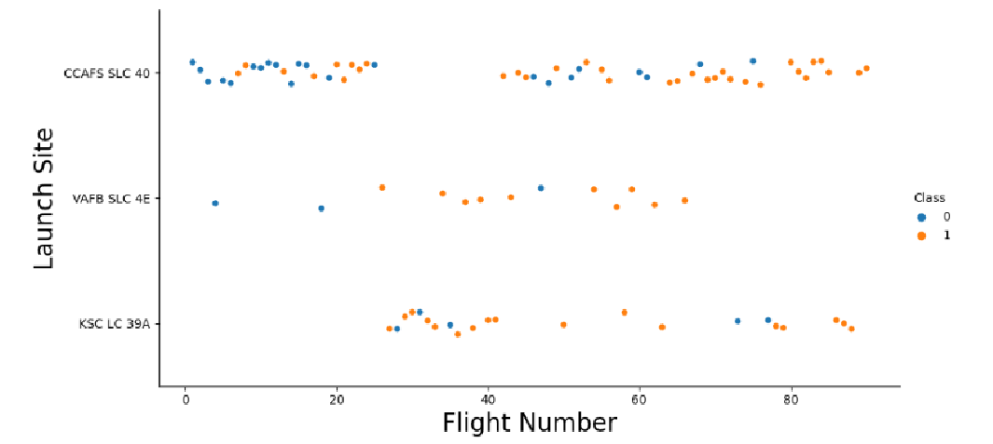
Flight Number vs. Launch Site
The data analysis indicates a trend where earlier flights exhibited a lower success rate, as indicated by the blue markers representing failures, while later flights demonstrated a higher success rate, represented by orange markers indicating successes. Approximately half of all launches originated from the CCAFS SLC 40 launch site. Moreover, launch sites like VAFB SLC 4E and KSC LC 39A boasted higher success rates. These observations lead to the inference that newer launches tend to have a higher success rate, reflecting an evolving trend in launch outcomes.

Slide 17
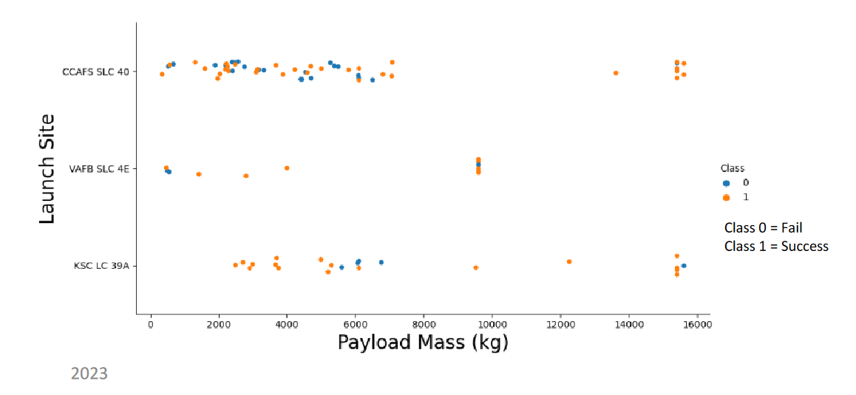
Payload vs. Launch Site
The data analysis reveals a clear relationship between payload mass (kg) and launch success rate, indicating that higher payload masses tend to correspond to higher success rates. Notably, a significant portion of launches with payloads exceeding 7,000 kg resulted in successful missions. Additionally, KSC LC 39A stands out for achieving a flawless 100% success rate for launches with payloads under 5,500 kg. Conversely, it's evident that VAFB SKC 4E has yet to conduct launches involving payloads surpassing approximately 10,000 kg, suggesting limitations in its capacity for handling heavier payloads.

Slide 18
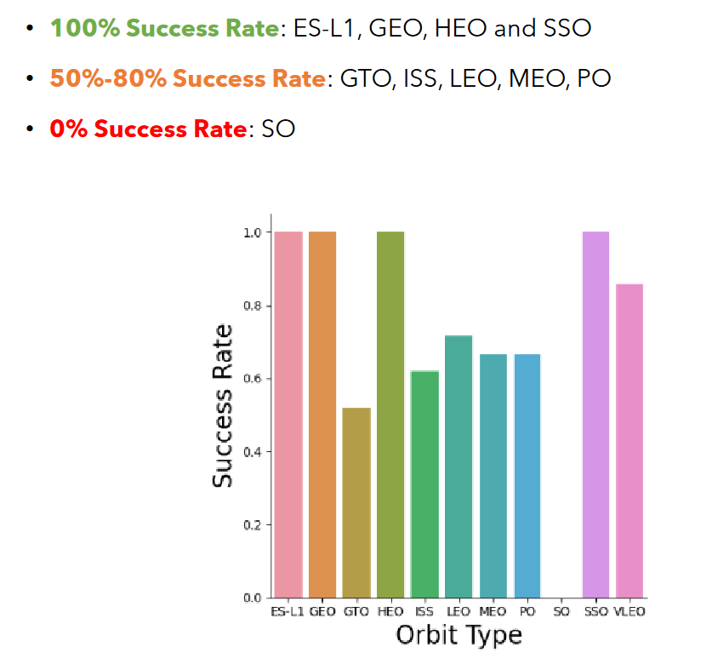
Success Rate vs. Orbit Type

Slide 19
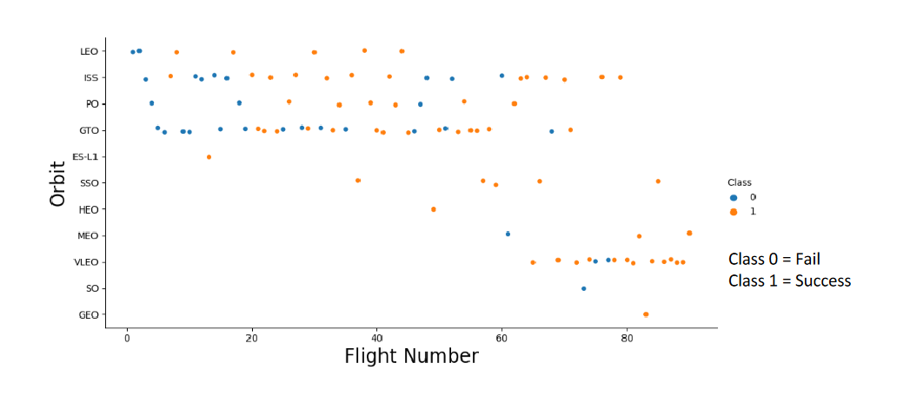
Flight Number vs. Orbit Type

Slide 20
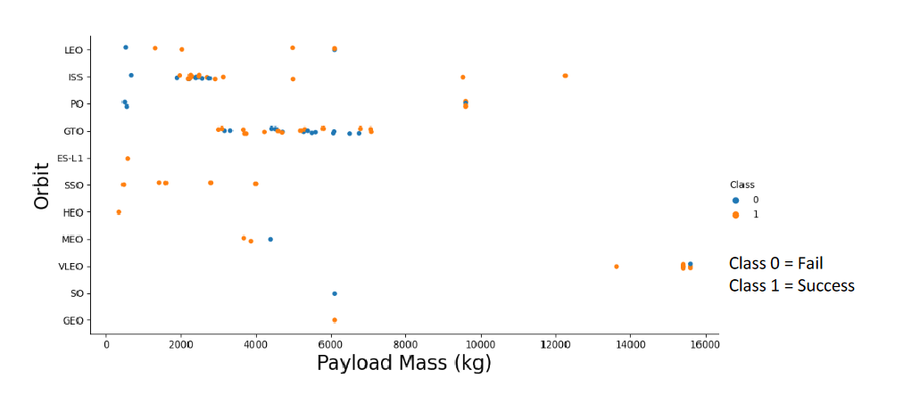
Payload vs. Orbit Type

Slide 21
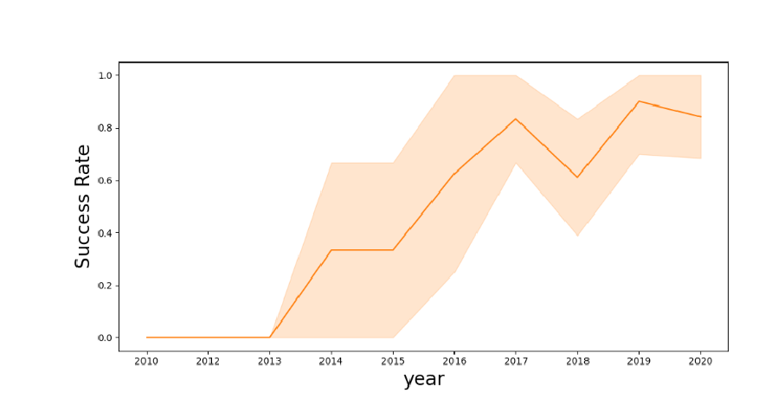
Launch Success Yearly Trend
The data analysis indicates an improvement in the success rate during two distinct periods: from 2013 to 2017 and from 2018 to 2019. However, there was a decrease in success rates observed from 2017 to 2018 and from 2019 to 2020. Despite these fluctuations, the overall trend shows an improvement in the success rate since 2013.

Slide 22
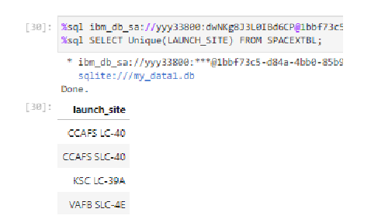
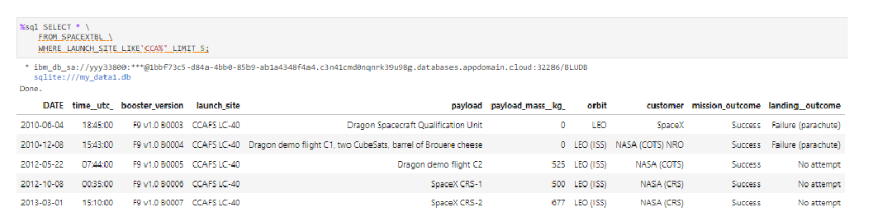
All Launch Site Names
CCAFS LC-40
CCAFS SLC-40
KSC LC-39A
VAFB SLC-4E

Slide 23
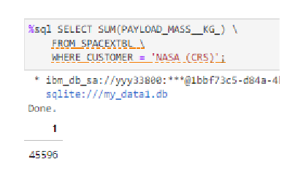
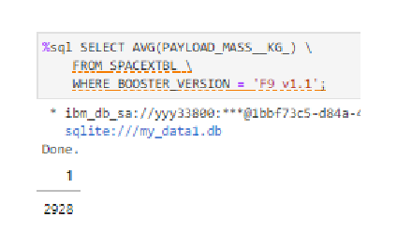
Launch Site Names Begin with 'CCA'

Slide 24
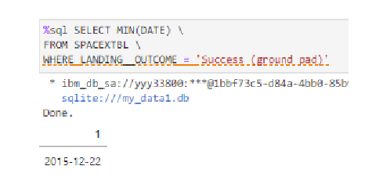
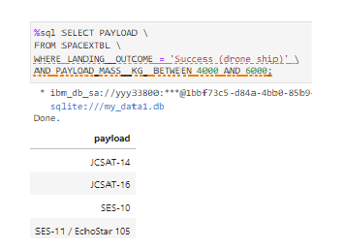
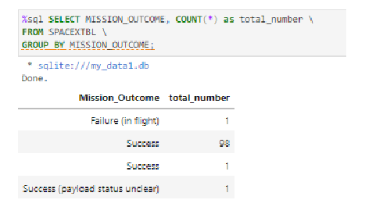
Total Number of Successful and Failure Mission Outcomes
Succesfull landing:
Booster Drone Ship Landing

Slide 25
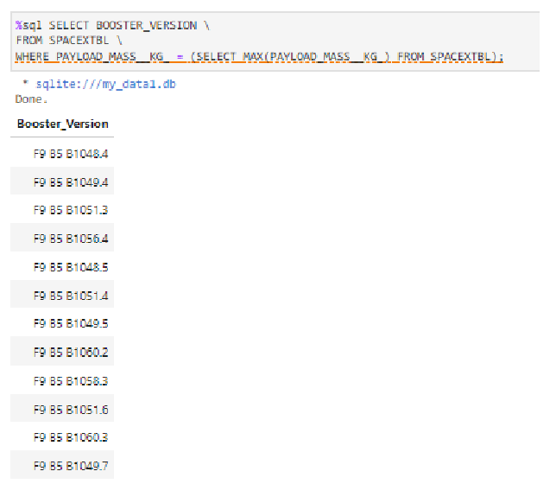
Boosters Carried Maximum Payload

Slide 26
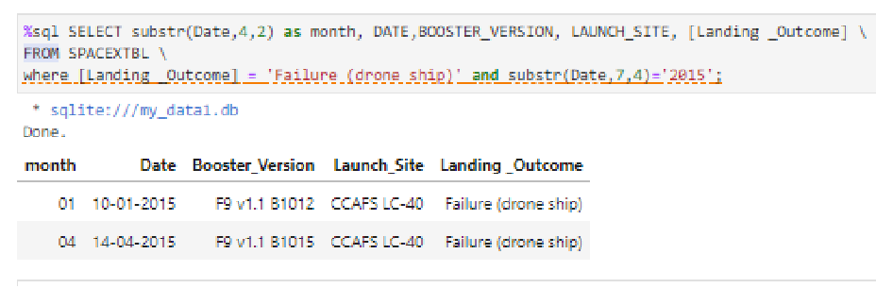
2015 Launch Records

Slide 27
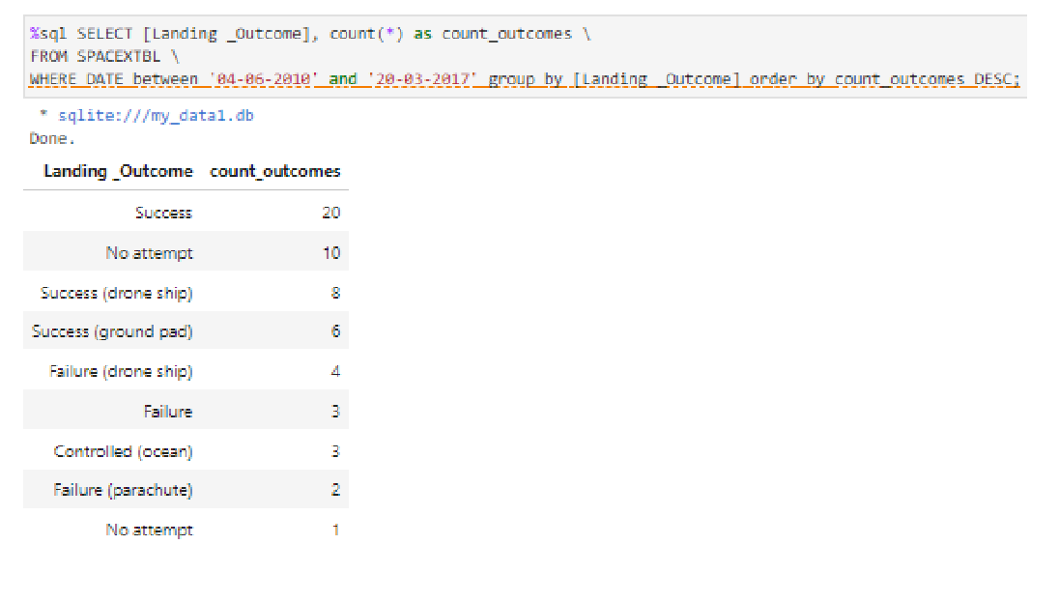
Rank Landing Outcomes Between 2010-06-04 and 2017-03-20

Slide 28

Section 3

Slide 29
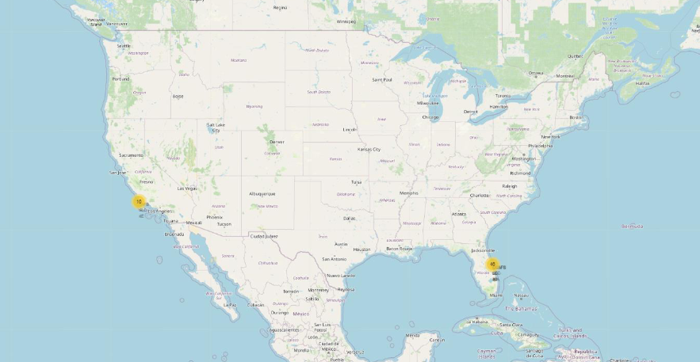
Launch sites
Launch sites located near the equator offer distinct advantages due to Earth's rotational speed, facilitating launches into equatorial orbits with greater efficiency. Proximity to the equator enables rockets to benefit from the Earth's rotation, providing an additional natural boost for achieving a prograde orbit. This natural boost reduces the need for extra fuel and boosters, ultimately saving costs associated with the launch.

Slide 30
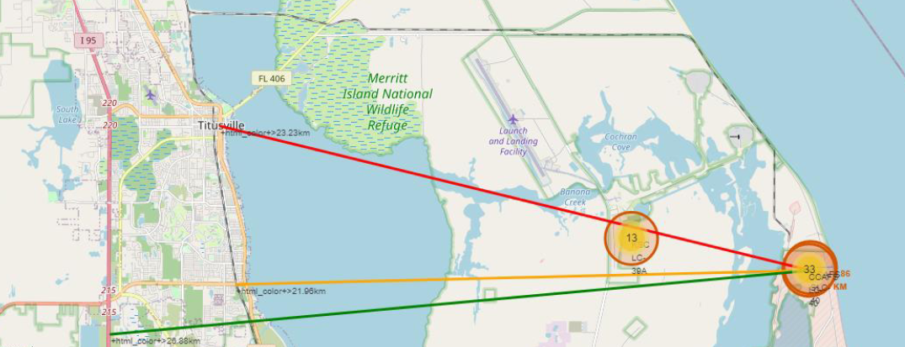
Distance to proximities

Slide 31
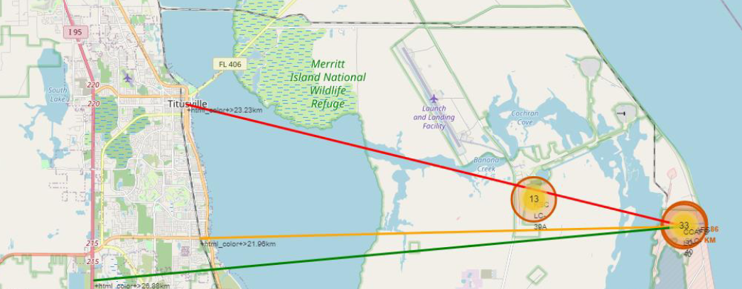
Distance to proximities
Replace <Folium map screenshot 3> title with an appropriate title
Explore the generated folium map and show the screenshot of a selected launch site to its proximities such as railway, highway, coastline, with distance calculated and displayed
Explain the important elements and findings on the screenshot

Slide 32

Section 4

Slide 33
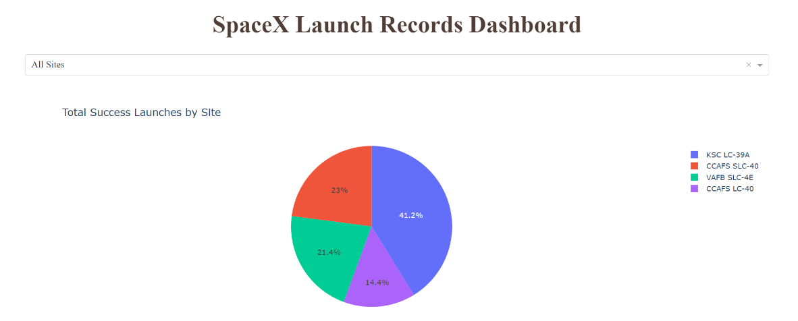
Launch success

Slide 34
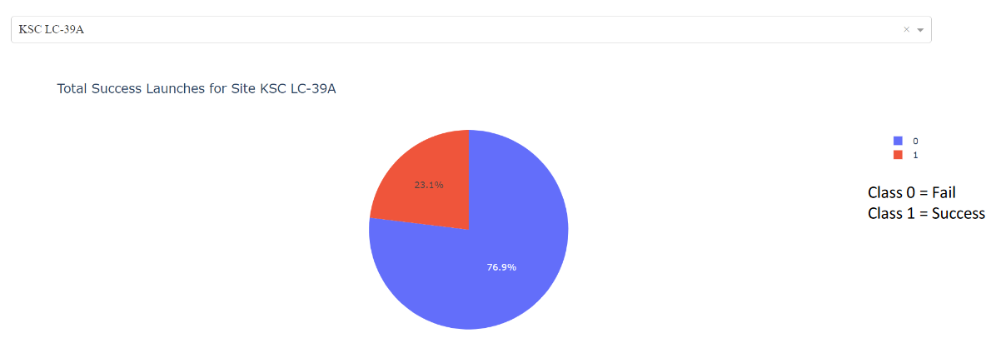
KSC LC-29A
Replace <Dashboard screenshot 2> title with an appropriate title
Show the screenshot of the piechart for the launch site with highest launch success ratio
Explain the important elements and findings on the screenshot

Slide 35
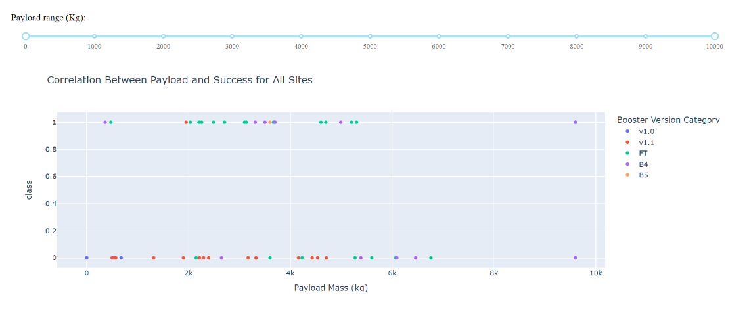
Payload mass
Replace <Dashboard screenshot 3> title with an appropriate title
Show screenshots of Payload vs. Launch Outcome scatter plot for all sites, with different payload selected in the range slider
Explain the important elements and findings on the screenshot, such as which payload range or booster version have the largest success rate, etc.

Slide 36

Section 5

Slide 37
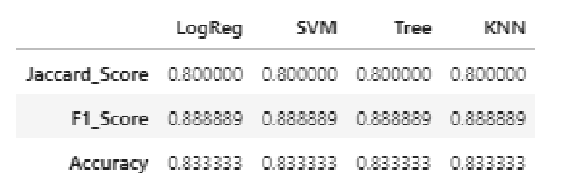
Classification Accuracy
Visualize the built model accuracy for all built classification models, in a bar chart
Find which model has the highest classification accuracy

Slide 38
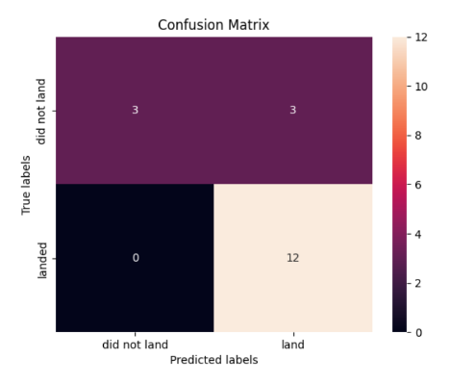
Confusion Matrix

Slide 39
Conclusions
In terms of model performance on the test set, the decision tree model slightly outperformed other models. Geographically, most launch sites are situated near the equator, leveraging Earth's rotational speed to achieve a prograde orbit efficiently and save costs by minimizing the need for additional fuel and boosters. Additionally, all launch sites are located close to the coast. Over time, there has been a notable increase in launch success rates. Specifically, KSC LC-39A boasts the highest success rate among launch sites and achieves a flawless 100% success rate for launches with payloads less than 5,500 kg. Certain orbits, including ES-L1, GEO, HEO, and SSO, exhibit a perfect 100% success rate. Moreover, across all launch sites, there's a clear trend indicating that higher payload masses correlate with higher success rates.

Slide 40


